Slide 1



Rethinking Indian Education: Breaking free From Rote Learning
Avash Banerjee
Parthib Kumar Das
Rudrakshee Banerjee
Atreyee Das
Holistic Development and Inquiry-Based

Slide 2


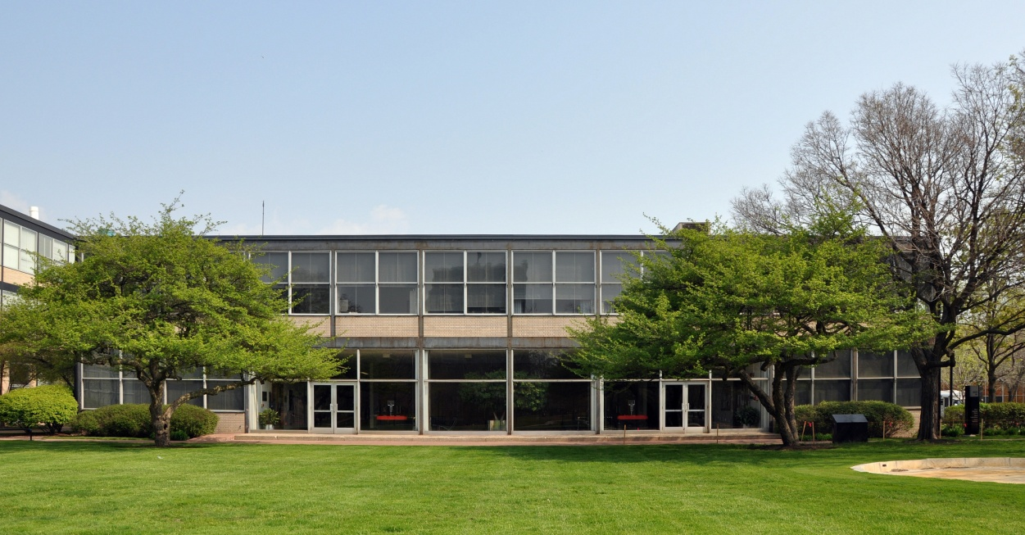
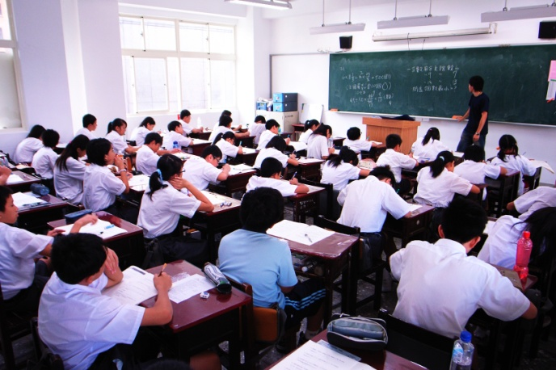
Overview of the Indian Education System
Diversity:
- Vast and diverse education system catering to a large and varied population.
Components:
- Encompasses primary, secondary, and higher
education with various boards and institutions.
Evolution:
- Shaped by historical, cultural, and societal factors
evolving over time.
Challenges and Achievements:
- Strides in increasing access and literacy rates, but challenges persist in quality and uniformity.

Slide 3

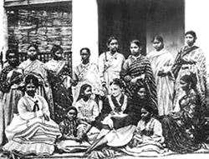
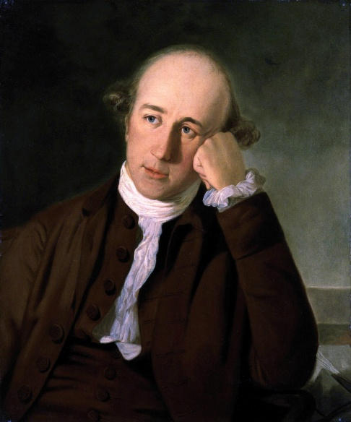

Historical Context
Legacy of Colonial Education System:
- Aimed at creating obedient administrators.
- Emphasized rote learning for conformity and control, leaving a lasting influence on educational norms.
Persistence of Rote Learning and Standardized Testing:
- Rote learning, involving memorization without comprehension, remains deeply entrenched.
- Standardized testing, a historical measure of academic success, continues to be a predominant evaluation method.

Slide 4
















Student Perspective
Impact of Exam Pressure:
- Chronic stress due to relentless pressure to excel in exams.
- Correlations found with symptoms of depression,
sleep disturbances, and even
suicidal ideation.
Shift from Joy of Learning to Competition:
- A shift from intrinsic motivation and the joy of learning to a focus on competition.
- Prioritizing short-term memorization over genuine understanding, impacting overall educational experience.

Slide 5

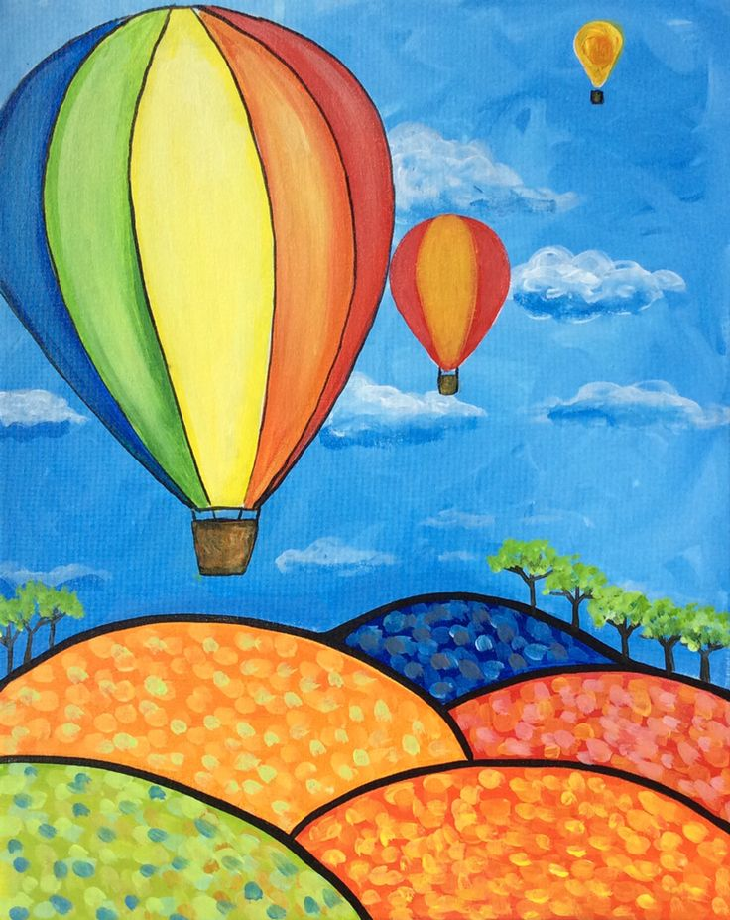

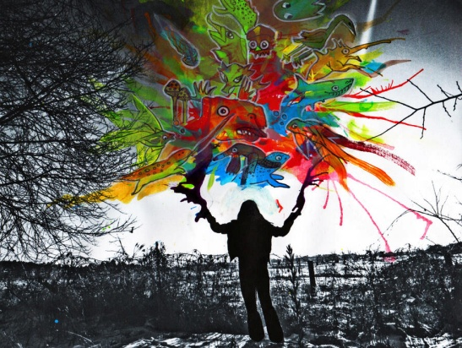

Educational Challenges
Stifled Creativity and Innovation:
- Rigid curriculums limit room for individual exploration and critical thinking.
- Students, accustomed to rote memorization, struggle with creative problem- solving.
Marginalization of Diverse Learning Styles:
- One-size-fits-all approach fails to cater to varied learning styles and abilities.
- Students with kinesthetic, auditory, or visual preferences are
often left behind, exacerbating existing inequalities.

Slide 6




Research Findings:
Negative Effects of Rote Learning:
- Superficial understanding, hindering critical thinking and problem-solving skills.
- Students prioritize memorization over comprehension, impacting real-world knowledge application.
Insights from Literature Review:
- Thorough examination of various sources, including peer-reviewed papers, government reports, and expert opinions.
- Highlights the consensus on the detrimental
effects of rote learning and the need for alternative
pedagogical approaches.

Slide 7


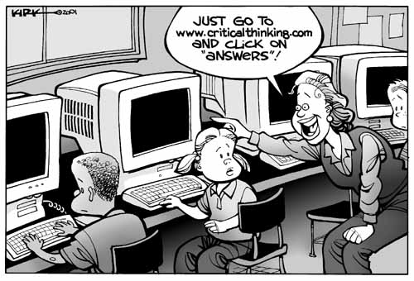


Individual_Impact:
Student Stress and Anxiety!!!
Chronic Stress Epidemic:
Relentless pressure to excel in exams contributes to a chronic stress epidemic.
Studies show significant correlations with symptoms of depression, sleep disturbances, and suicidal ideation.
Unhealthy Coping Mechanisms:
Students prioritize short-term memory gains
over genuine understanding.
Resort to unhealthy coping mechanisms like unhealthy eating habits and
sleep deprivation.

Slide 8



Individual_Impact: Compromised Well-Being
Neglect of Holistic Development:
Focus on exams over holistic development neglects
emotional, physical, and social needs.
Emotional exhaustion, decreased motivation, and
alienation from learning are prevalent.
Impact on Life Skills:
Hinders the development of crucial life skills such as stress management and emotional intelligence.
Compromised ability to foster healthy relationships and navigate challenges.

Slide 9


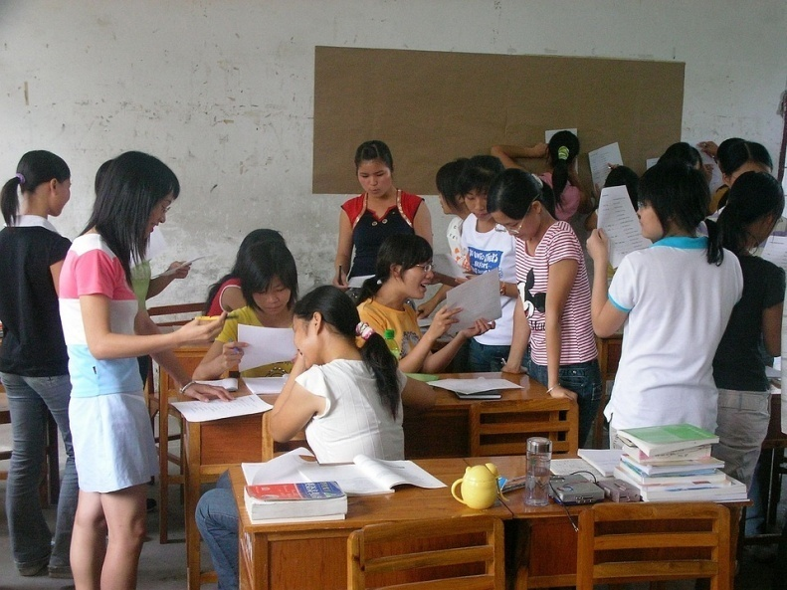

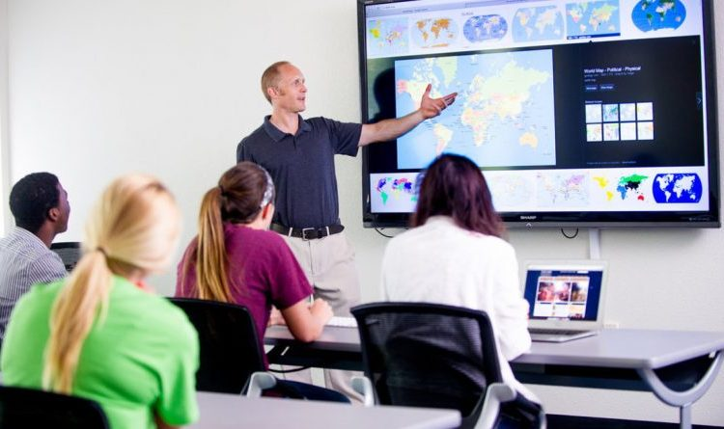

Solution and conclusion-
Holistic Reform Strategies
Fostering Inquiry-based Learning:
Prioritizing student curiosity, critical thinking,
and active problem-solving.
Encouraging students to ask questions, engage in research, and construct their own understanding.
Embracing Technology Integration:
Utilizing interactive platforms, simulations, and educational apps.
Revolutionizing classrooms for engaging, accessible, and effective learning experiences.

Slide 10




Solutions and conclusion- Holistic Reform Strategies (Continued)
Prioritizing Student Well-being:
- Integrating stress management techniques, and supportive environments.
- Promoting physical activity, arts, and sports for emotional resilience and social skills.
Acknowledging Challenges:
- Recognizing the complexities and challenges in reforming the entrenched system.
- Shifting from a focus on achieving high marks to nurturing holistic development.
Paving the Way for Transformation:
- Collaborative efforts between policymakers, educators, parents,
and society.

Slide 11



